Slide 1
Support Vector Machines

Slide 2

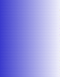
History of SVM
SVM is related to statistical learning theory [3]
SVM was first introduced in 1992 [1]
SVM becomes popular because of its success in handwritte₂n digit recognition
1.1% test error rate
SVM is now regarded as an important example of “kernel methods”, one of the key area in machine learning
19/12/27
2

Slide 3

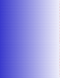
Linear Classifiers
x
f
_{y}est
denotes +1
denotes -1
w: weight vector
x: data vector
How would you classify this data?
f(x,w,b) = sign(w. x - b)
19/12/27
3

Slide 4

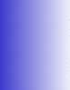
Linear Classifiers
α
x
f
_{y}est
denotes +1
denotes -1
f(x,w,b) = sign(w. x - b)
How would you classify this data?

Slide 5

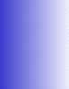
Linear Classifiers
α
x
f
_{y}est
denotes +1
denotes -1
f(x,w,b) = sign(w. x - b)
How would you classify this data?

Slide 6

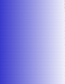
Linear Classifiers
α
x
f
_{y}est
denotes +1
denotes -1
f(x,w,b) = sign(w. x - b)
How would you classify this data?

Slide 7


Linear Classifiers
α
x
f
_{y}est
denotes +1
denotes -1
f(x,w,b) = sign(w. x - b)
Any of these would be fine..
..but which is best?

Slide 8
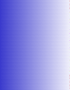
Classifier Margin
α
x
f
_{y}est
denotes +1
denotes -1
f(x,w,b) = sign(w. x - b)
Define the margin of a linear classifier as the width that the boundary could be increased by before hitting a
datapoint.

Slide 9

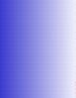
Maximum Margin
α
x
f
_{y}est
denotes +1
denotes -1
f(x,w,b) = sign(w. x - b)
The maximum margin linear classifier is the linear classifier with the, um, maximum margin.
This is the
simplest kind of SVM (Called an LSVM)
Linear SVM

Slide 10
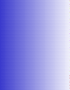


Maximum Margin
α
x
f
_{y}est
denotes +1
denotes -1
f(x,w,b) = sign(w. x + b)
The maximum margin linear classifier is the linear classifier with the, um, maximum margin.
This is the
Support Vectors are those datapoints that the margin pushes
up against
simplest kind of SVM (Called an
Linear SVM
LSVM)

Slide 11

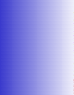
Why Maximum Margin?
denotes +1
denotes -1
f(x,w,b) = sign(w. x - b)
The maximum margin linear classifier is the linear classifier with the, um, maximum margin.
This is the
Support Vectors are those datapoints that the margin pushes up against
simplest kind of SVM (Called an
LSVM)
19/12/27
11

Slide 12


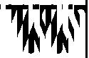
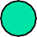

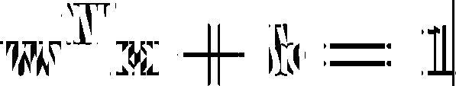

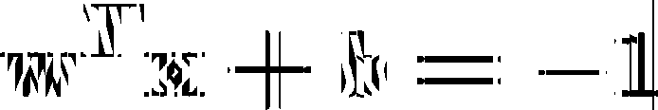
A Geometrical Interpretation
Class 2
α₈=0. 6
α₁₀=0
α =0
7
α =0
α₅=0
2
α₁=0.8
α =0
4
α₆=1.4
α₉=0
Class 1
α =0
3

Slide 13

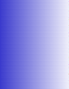
Non-linear SVMs: Feature spaces
General idea: the original input space can always be mapped to some higher-dimensional feature space where the training set is separable:
Φ: x → φ(x)

Slide 14

Choosing the Kernel Function
Probably the most tricky part of using SVM.
Polynomial Kernel – Non-Linear Data Classification
Radial or RBF Kernel – Non-Linear Data Classification
Linear Kernel – Linear Data Classification

Slide 15

Choosing the C Parameter Value
C is a regularization parameter that controls the trade off between the achieving a low training error and a low testing error that is the ability to generalize your classifier to unseen data.
In simple terms, C represents the width of the margin for classification purpose.
Higher C = Lesser Width Lower C = Higher Width
The Optimal value of C lies in between which needs to be calculated on the basis of model accuracy.

Slide 16

Choosing the Gamma Parameter
Intuitively, the gamma parameter defines how far the influence of a single training example reaches, with low values meaning 'far' and high values meaning 'close'. The gamma parameters can be seen as the inverse of the radius of influence of samples selected by the model as support vectors.
Optimal Value of gamma needs to be included otherwise Model can run into over fitting

Slide 17

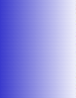
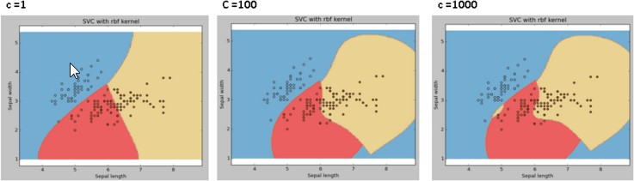
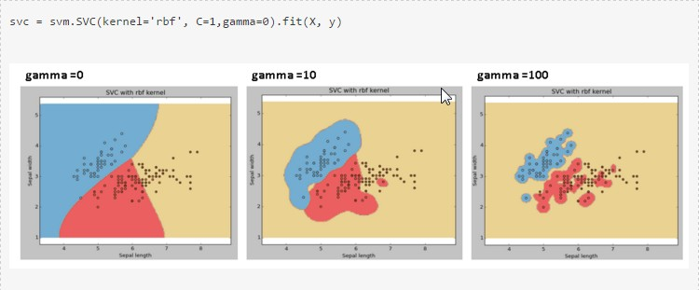
Effect of C & Gamma

Slide 18
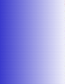
Summary: Steps for Classification
Select the kernel function to use
Select the Gamma Parameter to be used.
Select the parameter of the kernel function and the value of C
You can use the values suggested by the SVM software, or you can set apart a validation set to determine the values of the parameter

